Slide 1
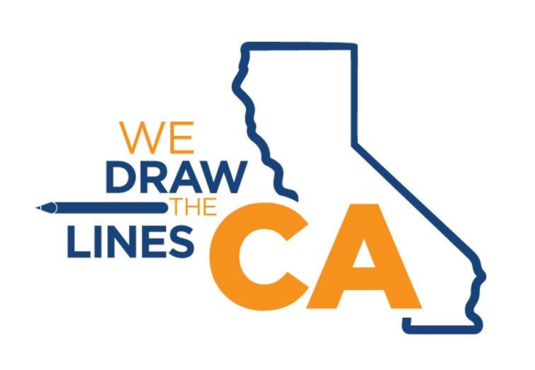
CRC Redistricting Presentation
California Citizens Redistricting Commission
WeDrawTheLinesCA.org

Slide 2
Reminder—No Public Input Will Be Taken Today
Per California Government Code Section 8253(a)(3)--Commission members and staff may not communicate with or receive communications about redistricting matters from anyone outside of a public hearing. Therefore, the Commission will not be taking any public input during these educational presentations.
To provide public input, please visit the Commission's website at: WeDrawTheLinesCA.org.

Slide 3
California Citizens Redistricting Commission
Why is redistricting important?
Why should you be involved?
Your role in the process
Redistricting has been used at times to exclude communities from political power. By fully participating in and monitoring the upcoming redistricting process, more communities may have a better opportunity to elect candidates of their choice who will voice their needs and interests.

Slide 4
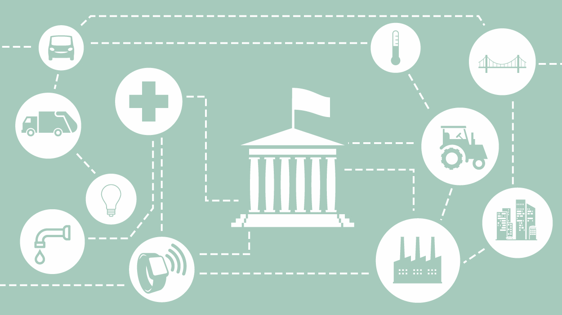
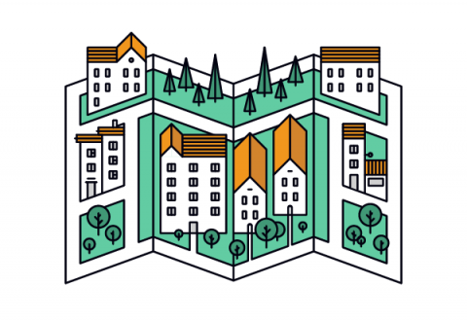
How Redistricting Affects You
Power to the People
Champion Your Issues
Funding Priorities
Community Boundaries

Slide 5
Different Redistricting Efforts
State—Congressional, State Senate, State Assembly, and Board of Equalization.
Counties—58 counties, some with their own process.
Cities—482 cities, some with their own process.
School Districts—1037 school districts, some with their own process.
Other Redistricting Efforts—water districts, community college districts, etc.

Slide 6
6 Line Drawing Criteria by Order
The Commission must follow these weighted criteria in this order when drawing district maps:
In addition, the place of residence of any incumbent or political candidate may not be considered in the creation of a map, and districts may not be drawn for the purpose of favoring or discriminating against an incumbent, political candidate, or political party.

Slide 7
Communities of Interest (COI)
Communities of Interest (COI)--A community of interest is a concentrated population which shares common social and economic interests that should be included within a single district for purposes of its effective and fair representation.
Examples include culture, areas in which the people share similar living standards, use the same transportation facilities, have similar work opportunities, or have access to the same media.
People can belong to multiple communities of interest.
Community of Interest is not the same as a district but are key building blocks of districts.

Slide 8
Draw Your CA!
Provide your input today at: https://drawmycalifornia.org/

Slide 9
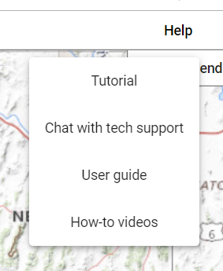
How to Get More Assistance
9
Tutorial
Chat with Tech Support
Draw My CA Community - User Guide
Draw MY CA Districts - User Guide
Draw My CA Community - How-To Videos
Draw My CA Districts - How-To Video
Sign Up for a Virtual Appointment
Email: contact@drawmycacommunity.org
Call the helpline at (510) 280-3305

Slide 10
In Person Assistance: Redistricting Access Centers
10
Fresno
Long Beach
Oakland
Sacramento
San Bernardino
San Diego
Publicly accessible computers
Redistricting software developed by the Statewide Database.
Staff available to support the public
Appointments are required to visit a Redistricting Access Center
See more on our flyer or at:
https://statewidedatabase.org/redistricting_access_centers/

Slide 11
11
Additional Ways to Provide Input
Our Website:
www.WeDrawTheLinesCA.org/contact
By Email:
VotersFirstAct@crc.ca.gov
By Mail:
California Citizens Redistricting Commission
721 Capitol Mall, Suite 260
Sacramento, CA 95814
Community Feedback on Visualizations Tool:
Community Feedback Form

Slide 12
Help Spread the Word
12

Slide 13
Timeline
February - July 2021: Education Presentations (California Redistricting Basics)
June - September 2021: Public Input Meetings (Communities of Interest)
August 12, 2021:Census Data Received by the State
September 20, 2021: Final dataset provided to Commission and Public with People in State Custody Reallocated
October - November 2021: Public Input Meetings/Line Drawing Sessions
No Later than November 15, 2021: Preliminary Draft District Maps Released *14 days following the release of Preliminary Draft District Maps, the Commission may not display any other maps for public comment during this period.
November-December 2021: Following Release of Preliminary Draft Maps: Additional Public Input Meetings and Line Drawing Sessions
December 2021: Possible additional draft District Maps Released
No Later than December 23, 2021: Display of Commission Approved Final Maps
No Later than December 27, 2021: Final District Maps Certified to Secretary of State

Slide 14
Reminder—No Public Input Will Be Taken Today
Per California Government Code Section 8253(a)(3)-- Commission members and staff may not communicate with or receive communications about redistricting matters from anyone outside of a public hearing. Therefore, the Commission will not be taking any public input during these presentations.
To provide public input, please visit the Commission's website at: WeDrawTheLinesCA.org.

Slide 15
Contact Us
To request an informational session, please contact the Commission or submit a request here.
California Citizens Redistricting Commission
721 Capitol Mall, Suite 260
Sacramento, CA 95814
(916) 323-0323
Anne.Marx@crc.ca.gov
Ashleigh.Howick@crc.ca.gov
Cell: (916) 879-6045
For more information about the Commission, please visit: WeDrawTheLinesCA.org
Social Media Handles: @WeDrawTheLinesCA

